Slide 1
Interrupts in TM4C
Reference: chapter 6, Mazidi

Slide 2
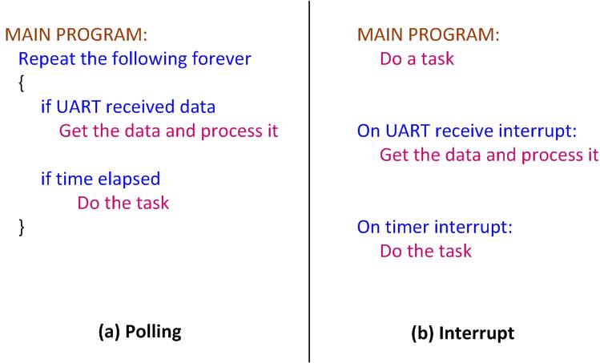
Polling vs. Interrupts

Slide 3
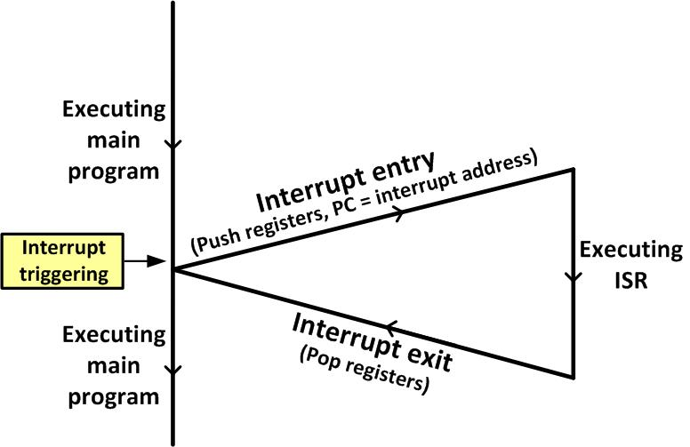
Main Program gets interrupted

Slide 4
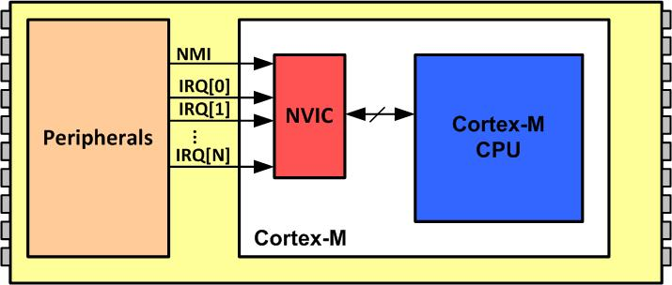
NVIC in ARM Cortex-M

Slide 5
Interrupt Vector Table for ARM Cortex-M
Interrupt # | Interrupt | Memory Location (Hex)
 | Stack Pointer initial value | 0x00000000
1 | Reset | 0x00000004
2 | NMI | 0x00000008
3 | Hard Fault | 0x0000000C
4 | Memory Management Fault | 0x00000010
5 | Bus Fault | 0x00000014
6 | Usage Fault (undefined instructions, divide by zero, unaligned memory access,...) | 0x00000018
7 | Reserved | 0x0000001C
8 | Reserved | 0x00000020
9 | Reserved | 0x00000024
10 | Reserved | 0x00000028
11 | SVCall | 0x0000002C
12 | Debug Monitor | 0x00000030
13 | Reserved | 0x00000034
14 | PendSV | 0x00000038
15 | SysTick | 0x0000003C
16 | IRQ 0 for peripherals | 0x00000040
17 | IRQ 1 for peripherals | 0x00000044
… | … | …
255 | IRQ 239 for peripherals | 0x000003FC

Slide 6
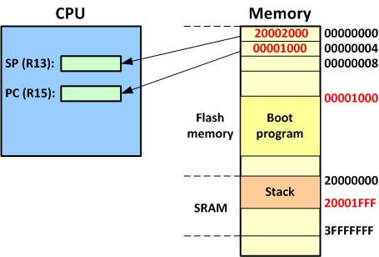
Going from Reset to Boot Program

Slide 7
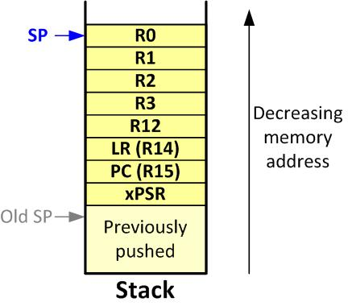
ARM Cortex-M Stack Frame upon Interrupt

Slide 8
IRQ assignment in Tiva ARM TM123GH6PM
INT# | IRQ# | Vector location | Device
1-15 | none | 0000 0000 to 0000 003C | CPU Exception (set by ARM)
16 | 0 | 0000 0040 | GPIO PORT A
17 | 1 | 0000 0044 | GPIO PORT B
18 | 2 | 0000 0048 | GPIO PORT C
19 | 3 | 0000 004C | GPIO PORT D
20 | 4 | 0000 0050 | GPIO PORT E
21 | 5 | 0000 0054 | UART0
22 | 6 | 0000 0058 | UART1
23 | 7 | 0000 005C | SSI0
24 | 8 | 0000 0060 | I2C0
25 | 9 | 0000 0064 | PWM0 Fault
26 | 10 | 0000 0068 | PWM0 Generator 0
27 | 11 | 0000 006C | PWM0 Generator 1
28 | 12 | 0000 0070 | PWM0 Generator 2

Slide 9
IRQ assignment in Tiva ARM TM123GH6PM(Cont.)
INT# | IRQ# | Vector location | Device
29 | 13 | 0000 0074 | QEI0
30 | 14 | 0000 0078 | ADC0 Sequence 0
31 | 15 | 0000 007C | ADC0 Sequence 1
32 | 16 | 0000 0080 | ADC0 Sequence 2
33 | 17 | 0000 0084 | ADC0 Sequence 3
34 | 18 | 0000 0088 | Watchdog Timers 0 and 1
35 | 19 | 0000 008C | 16/32-Bit Timer 0A
36 | 20 | 0000 0090 | 16/32-Bit Timer 0B
37 | 21 | 0000 0094 | 16/32-Bit Timer 1A
38 | 22 | 0000 0098 | 16/32-Bit Timer 1B
39 | 23 | 0000 009C | 16/32-Bit Timer 2A
40 | 24 | 0000 00A0 | 16/32-Bit Timer 2B
41 | 25 | 0000 00A4 | Analog Comparator 0
42 | 26 | 0000 00A8 | Analog Comparator 1

Slide 10
IRQ assignment in Tiva ARM TM123GH6PM(Cont.)
INT# | IRQ# | Vector location | Device
43 | 27 | - | Reserved
44 | 28 | 0000 00B0 | System Control
45 | 29 | 0000 00B4 | Flash Memory Control and EEPROM Control
46 | 30 | 0000 00B8 | GPIO Port F
47-48 | 31-32 | - | Reserved
49 | 33 | 0000 00C4 | UART2
50 | 34 | 0000 00C8 | SSI1
51 | 35 | 0000 00CC | 16/32-Bit Timer 3A
52 | 36 | 0000 00D0 | 16-32-Bit Timer 3B
53 | 37 | 0000 00D4 | I2C1
54 | 38 | 0000 00D8 | QEI1
55 | 39 | 0000 00DC | CAN0
56 | 40 | 0000 00E0 | CAN1
57-58 | 41-42 | - | Reserved

Slide 11
IRQ assignment in Tiva ARM TM123GH6PM(Cont.)
INT# | IRQ# | Vector location | Device
59 | 43 | 0000 00EC | Hibernation Module
60 | 44 | 0000 00F0 | USB
61 | 45 | 0000 00F4 | PWM Generator 3
62 | 46 | 0000 00F8 | µDMA Software
63 | 47 | 0000 00FC | µDMA Error
64 | 48 | 0000 0100 | ADC1 Sequence 0
65 | 49 | 0000 0104 | ADC1 Sequence 1
66 | 50 | 0000 0108 | ADC1 Sequence 2
67 | 51 | 0000 010C | ADC1 Sequence 3
68-72 | 52-56 | - | Reserved
73 | 57 | 0000 0124 | SSI2
74 | 58 | 0000 0128 | SSI3
75 | 59 | 0000 012C | UART3
76 | 60 | 0000 0130 | UART4

Slide 12
IRQ assignment in Tiva ARM TM123GH6PM(Cont.)
INT# | IRQ# | Vector location | Device
77 | 61 | 0000 0134 | UART5
78 | 62 | 0000 0138 | UART6
79 | 63 | 0000 013C | UART7
80-83 | 64-67 | - | Reserved
84 | 68 | 0000 0150 | I2C2
85 | 69 | 0000 0154 | I2C3
86 | 70 | 0000 0158 | 16/32-Bit Timer 4A
87 | 71 | 0000 015C | 16/32-Bit Timer 4B
88-107 | 72-91 | - | Reserved
108 | 92 | 0000 01B0 | 16/32-Bit Timer 5A
109 | 93 | 0000 01B4 | 16/32-Bit Timer 5B
110 | 94 | 0000 01B8 | 32/64-Bit Timer 0A
111 | 95 | 0000 01BC | 32/64-Bit Timer 0B
112 | 96 | 0000 01C0 | 32/64-Bit Timer 1A

Slide 13
IRQ assignment in Tiva ARM TM123GH6PM(Cont.)
INT# | IRQ# | Vector location | Device
113 | 97 | 0000 01C4 | 32/64-Bit Timer 1B
114 | 98 | 0000 01C8 | 32/64-Bit Timer 2A
115 | 99 | 0000 01CC | 32/64-Bit Timer 2B
116 | 100 | 0000 01D0 | 32/64-Bit Timer 3A
117 | 101 | 0000 01D4 | 32/64-Bit Timer 3B
118 | 102 | 0000 01D8 | 32/64-Bit Timer 4A
119 | 103 | 0000 01DC | 32/64-Bit Timer 4B
120 | 104 | 0000 01E0 | 32/64-Bit Timer 5A
121 | 105 | 0000 01E4 | 32/64-Bit Timer 5B
122 | 106 | 0000 01E8 | System Exception (imprecise)
123-149 | 107-133 | - | Reserved
150 | 134 | 0000 0258 | PWM Generator 0
151 | 135 | 0000 025C | PWM Generator 1
152 | 136 | 0000 0260 | PWM Generator 2
153 | 137 | 0000 0264 | PWM Generator 3
154 | 138 | 0000 0268 | PWM1 Fault

Slide 14
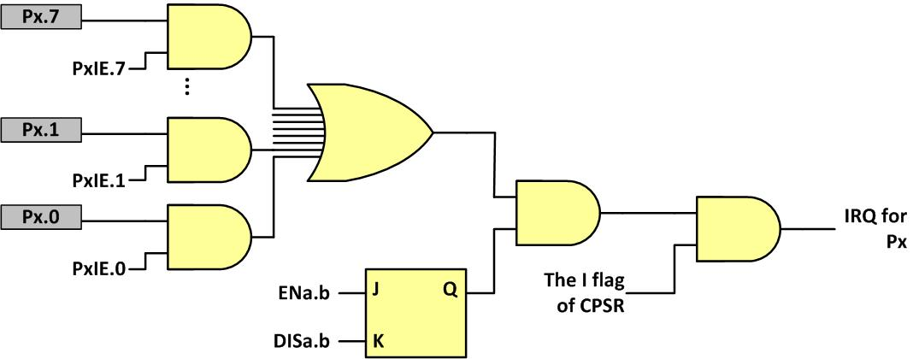
Interrupt enabling with all 3 levels

Slide 15
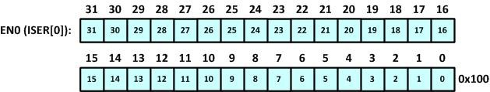
Interrupts 0–31 Set Enable (EN0)

Slide 16
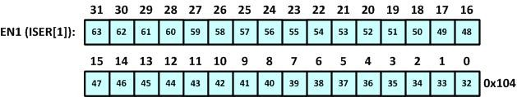
Interrupts 32–63 Set Enable (EN1)

Slide 17
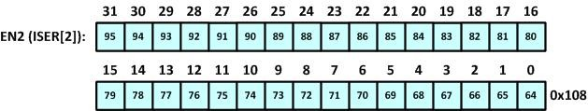
Interrupts 64–95 Set Enable (EN2)

Slide 18
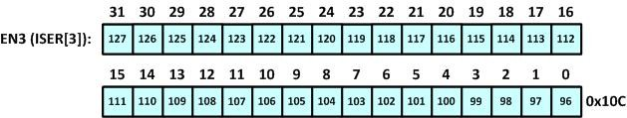
Interrupts 94–127 Set Enable (EN3)

Slide 19
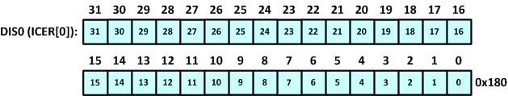
Interrupts 0–31 Clear Enable (DIS0)

Slide 20
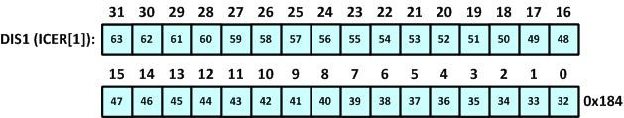
Interrupts 32–63 Clear Enable (DIS1)

Slide 21
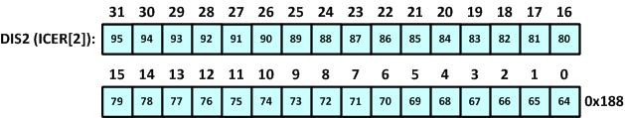
Interrupts 64–95 Clear Enable (DIS2)

Slide 22
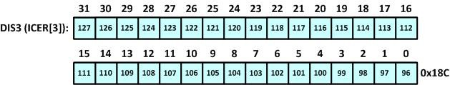
Interrupts 96–127 Clear Enable (DIS3)

Slide 23

Enabling and Disabling an Interrupt

Slide 24
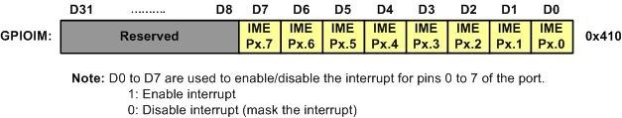
GPIO Interrupt Mask (GPIOIM)

Slide 25
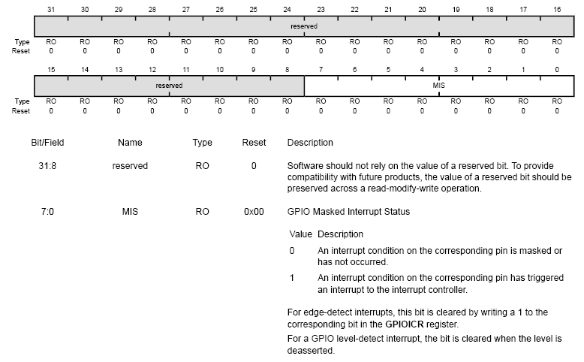
Masked Interrupt Status (GPIOMIS)

Slide 26
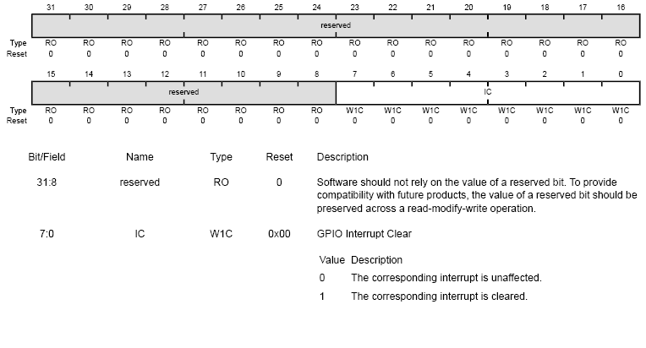
GPIO Interrupt Clear (GPIOICR)
ISR should clear respective bits in this register before exit, otherwise interrupt will be called again and again

Slide 27
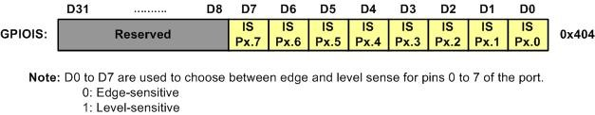
GPIO Interrupt Sense (GPIOIS)

Slide 28
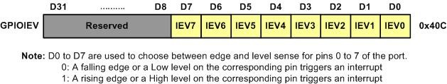
GPIOIEV

Slide 29
Using GPIOIM and GPIOIEV Registers
IS.n (interrupt sense) | IEV.n (Interrupt Event)
0 | 0 | Falling edge
0 | 1 | Rising edge
1 | 0 | Low level
1 | 1 | High level

Slide 30
Enable interrupt at both edges
Set bits in GPIOIBE register
GPIOIBE register bits overwrite the decision in GPIOIEV

Slide 31
Interrupt handler routine
Open startup file
Locate handler routine and rename it with your desired name
Using “extern” mention that this routine is written in another code file (i.e., your main .c file)

Slide 32
Example -1
Thread mode: RGB lights turn on after every second
Handler mode: Green Led blinks three times after 500ms

Slide 33
Example – 2
Thread mode: RGB lights turn on after every second
Handler mode 1(SW1): Green Led blinks three times after 500ms
Handler mode 2(SW2): Red Led blinks three times after 500ms

Slide 34
Interrupt Priority for ARM Cortex-M
Interrupt # | Interrupt | Priority Level
0 | Stack Pointer initial value
1 | Reset | -3 Highest
2 | NMI | -2
3 | Hard Fault | -1
4 | Memory Management Fault | Programmable
5 | Bus Fault | Programmable
6 | Usage Fault (undefined instructions, divide by zero, unaligned memory access,....) | Programmable
7 | Reserved | Programmable
8 | Reserved | Programmable
9 | Reserved | Programmable
10 | Reserved | Programmable
11 | SVCall | Programmable
12 | Debug Monitor | Programmable
13 | Reserved | Programmable
14 | PendSV | Programmable
15 | SysTick | Programmable
16 | IRQ 0 for peripherals | Programmable
17 | IRQ 1 for peripherals | Programmable
… | … | Programmable
255 | IRQ 239 for peripherals | Programmable

Slide 35
Interrupt Priority in TI ARM
Priorities of INT3 to INT255 are programmable
Lower val has highest priority
Levels are 0 to 7

Slide 36
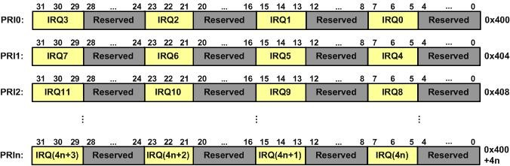
PRIn Registers
PRIn=IRQ(4n), IRQ(4n+1), IRQ(4n+2), IRQ(4n+3)

